Slide 1
DAT Class 5
Pandas & Numpy Crash Course

Slide 2
Unit 2 Schedule
GA DAT 06/24
Class 1: Pandas Fundamentals: Selection, Querying, Grouping
Class 2: Data Cleaning, Additional Operations
Class 3: Working with dates / Multilevel indices
Class 4: Graphing / Data Visualization
Class 5: Class presentations, Statistical Inference.

Slide 3
Numpy & Pandas: An Introduction
Overview
Give students a brief but coherent overview of Numpy & Pandas, plus the role they serve in the python ecosystem
Important Note
Be prepared to handle issues with installation here.
Learning Objectives
In this lesson, students will:
Get their Jupyter notebook up and running
Introduce students to IPython computing environment
Introduce students to numpy arrays & pandas dataframes
Duration
45 min - 1 hour

Slide 4
Suggested Agenda
Time | Activity | Purpose
0:00 - 0:15 | Anaconda Download + Installation | Getting everyone’s install correct, introduction to Jupyter notebook
0:16 - 0:30 | Numpy Introduction | Discuss students the important details of what makes numpy unique, its role in data science ecosystem
0:31 - 0:45 | Pandas Introduction | What it does, how it interacts with numpy, what dataframes are.
0:46 - 0:50 | Summary | Finish this portion of the lesson by having students

Slide 5
Materials and Preparation
Time spent on this lesson might be highly variable depending on how difficult a time people have with getting their operating environment up and running.
Besides getting everyone’s Jupyter Notebook up and running, focus on making sure everyone has a broad conception about what makes numpy & pandas unique, and how they interact with one another
Wrap this lesson up by using pd.read_csv() to load in a dataframe

Slide 6
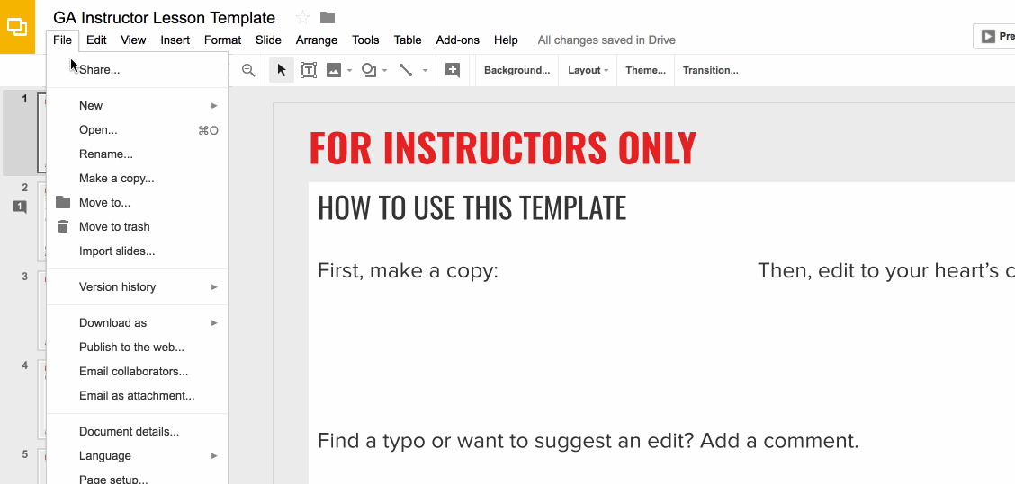
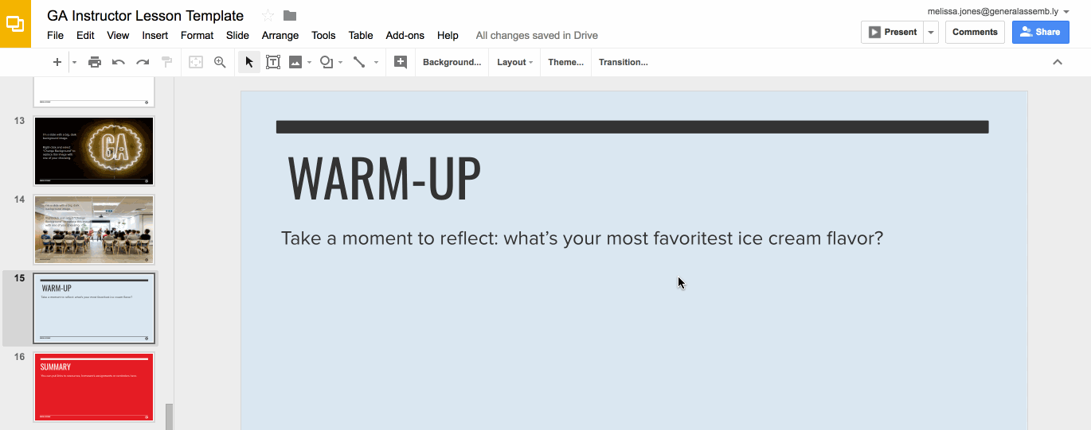
Preparation (Continued)
Ready to customize this lesson?
First things first, make a copy of this presentation. You’ll then be able to edit to your 💗’s content.
Find a typo or want to suggest an edit?
Add a comment. Our Product Advisory Board will review and incorporate your suggestions.

Slide 7

Preparation (Continued)
Remember to press Command F and do a search for instances of brackets in the deck. All instances of brackets denote places where instructors must fill in information/customize prior to presenting in class.

Slide 8
Differentiation and Extensions
This is a suggestion for a way in which instructors might change up this lesson to meet the needs of more advanced or less advanced students.
This is another suggestion.
This is another suggestion.
Be sure to link to any supplemental/optional materials on this slide.

Slide 9
Numpy & Pandas: An Introduction
Python For Data
Notes:
X MINUTES
TALKING POINTS
This is a suggested talking point.
This is another.
TEACHING TIPS
This is a suggestion for the instructor on something to do before, during or after presenting this slide.
This is another suggestion.

Slide 10
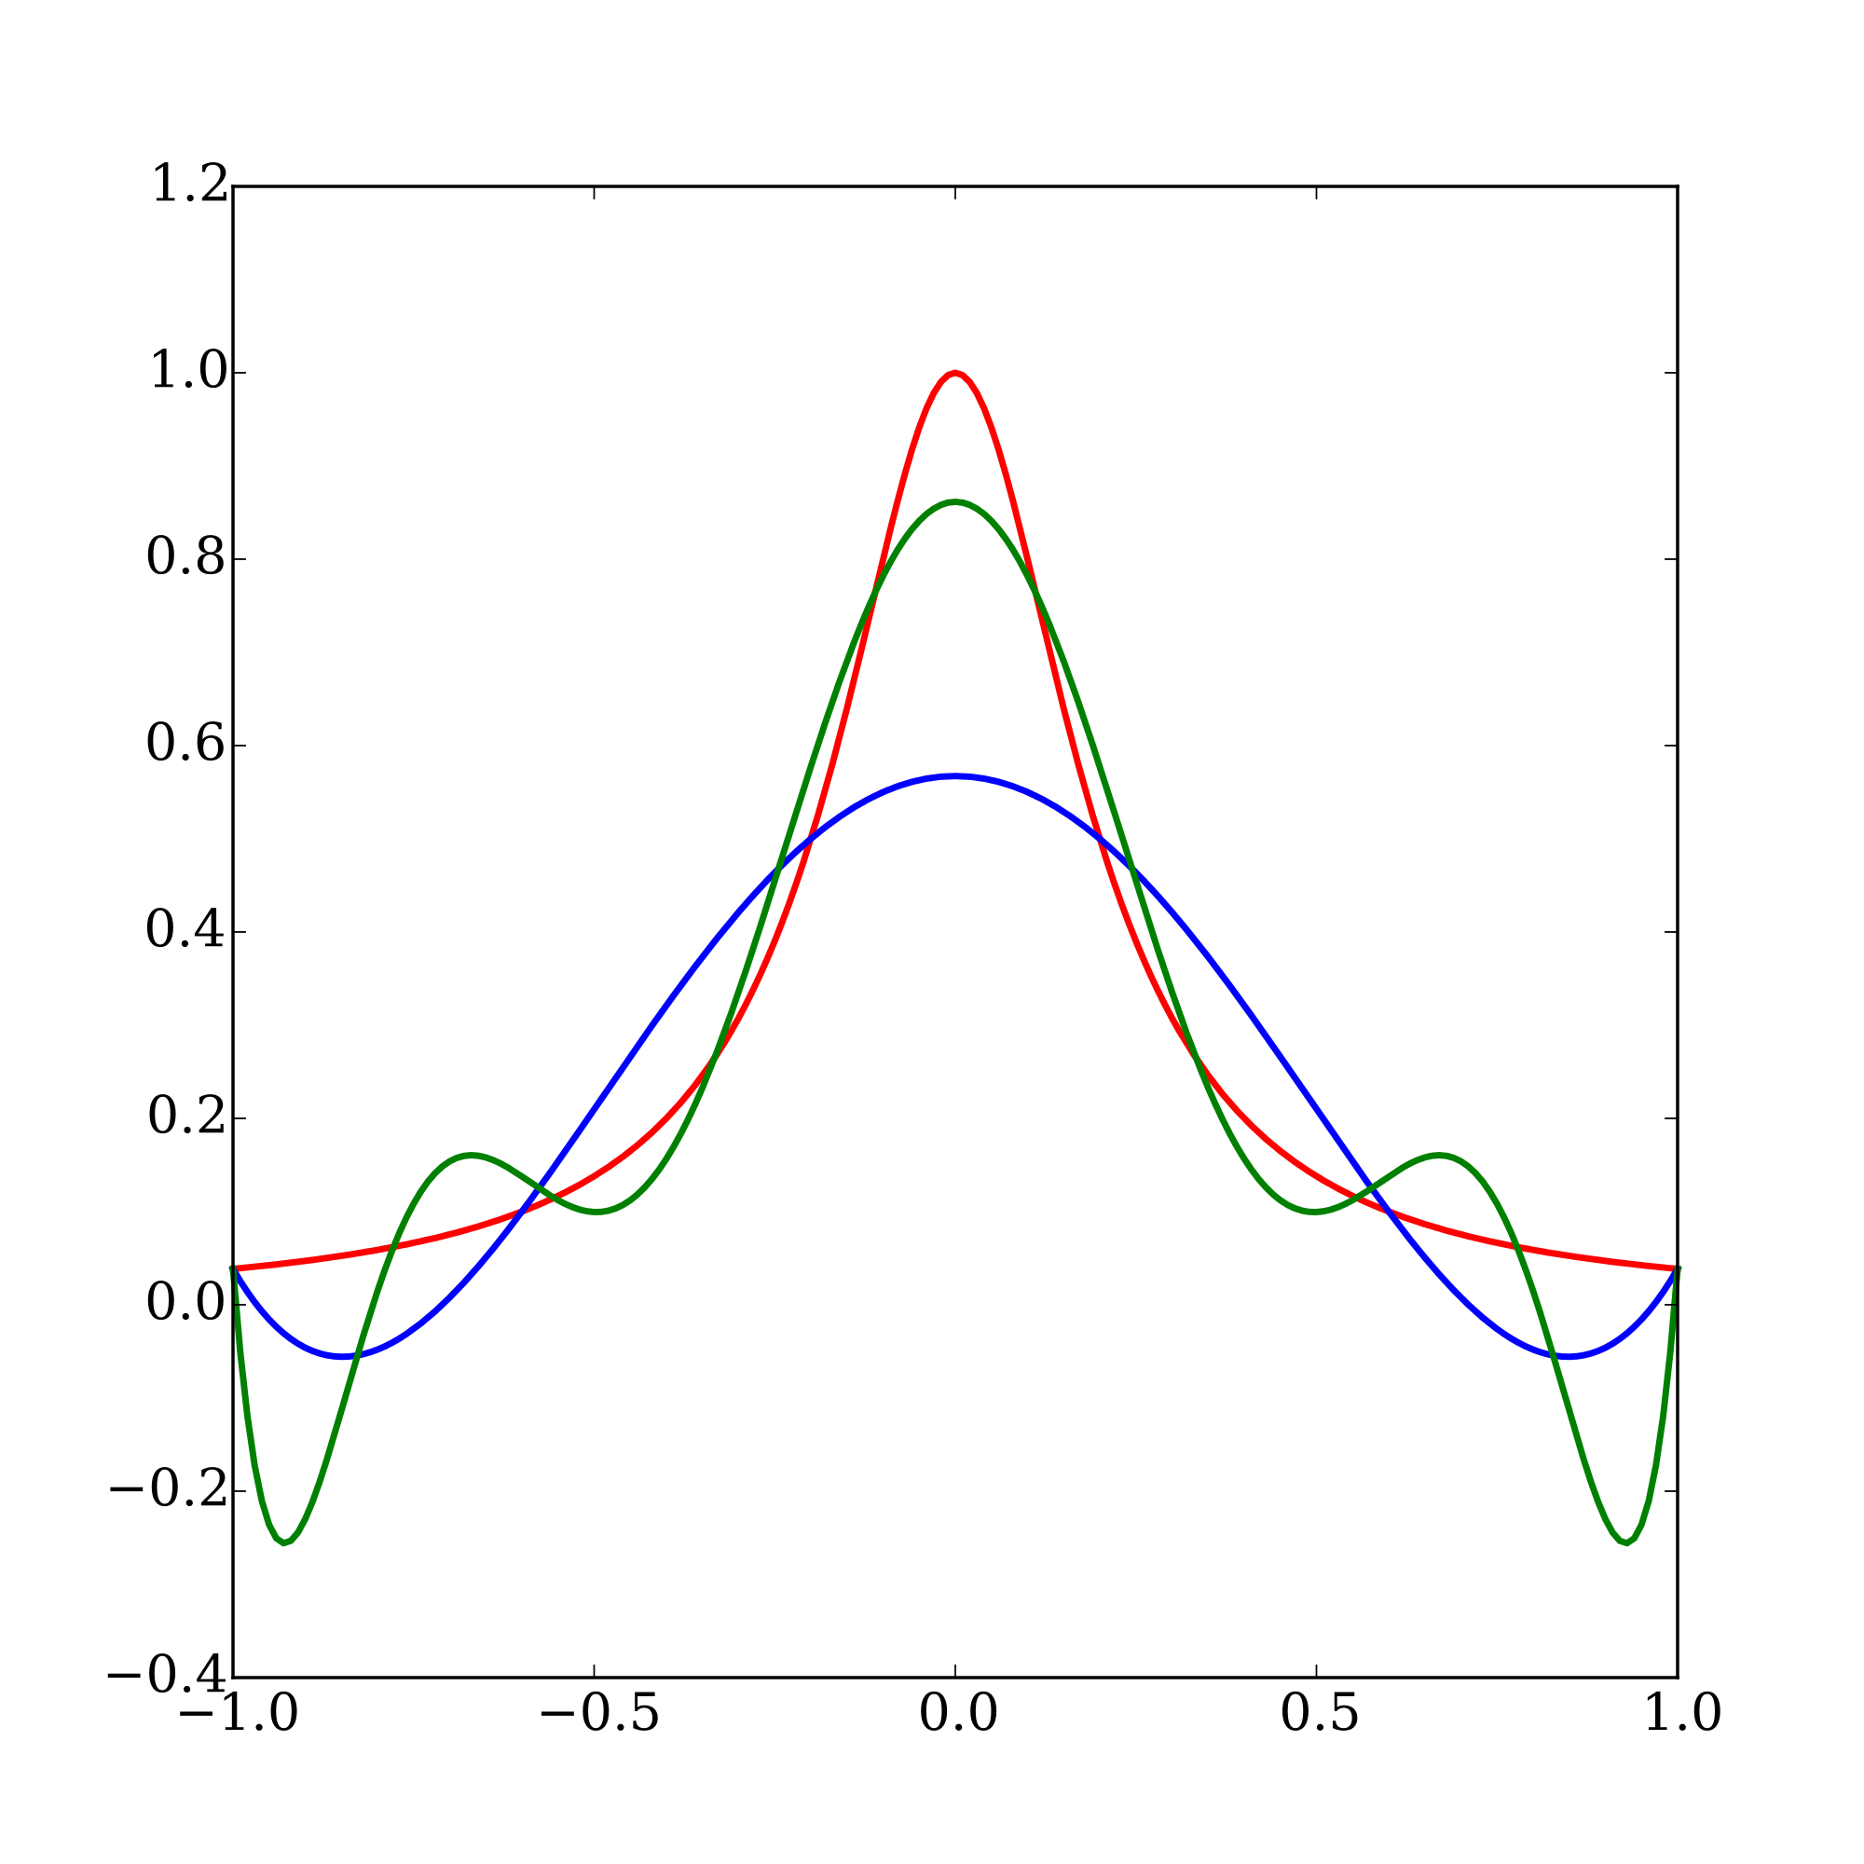
Python and Data: How They Work Together
Core Python language is not good for data analysis
Wasn’t built for it originally
Modern data analysis requires data structures that aren’t handled by native Python
But Python is everyone’s favorite language…..
Scipy ecosystem was built to make data-intensive computing feasible using Python
Notes:
3-5 MINUTES
TALKING POINTS
Emphasize that it’s not python itself that’s good for data analysis, but specific libraries built on top of it
Good idea to go to scipy.org to give students a better introduction to the ecosystem

Slide 11
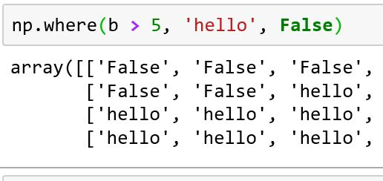
Numpy: Where It All Starts
Numpy is the most foundational of the libraries in the Scipy ecosystem
Allows you to perform computations on large amounts of data at one time
Fundamental data structure is the 2D-array
Notes:
3-5 MINUTES
TALKING POINTS
Go to Jupyter notebook after this slide to import numpy and type in a few commands to demonstrate what it does

Slide 12
Numpy: Where It All Starts
Built from the ground up for fast performance
Is only Python by appearance: compiles to C
Library is very well developed, has 500+ different methods built into it
Is the base of other data libraries built on top of it
Notes:
3-5 MINUTES
TALKING POINTS
Go to Jupyter notebook after this slide to import numpy and type in a few commands to demonstrate what it does

Slide 13
Numpy: Where It All Starts
Arrays are built around the notion of axes:
Axis 1: operates across rows
Axis 0: operates across columns
Frequent argument that can be specified in different methods
Default is usually 0
Notes:
3-5 MINUTES
TALKING POINTS
Go to Jupyter notebook after this slide to import numpy and type in a few commands to demonstrate what it does

Slide 14
Pandas
Python For Data
Notes:
X MINUTES
TALKING POINTS
This is a suggested talking point.
This is another.
TEACHING TIPS
This is a suggestion for the instructor on something to do before, during or after presenting this slide.
This is another suggestion.

Slide 15
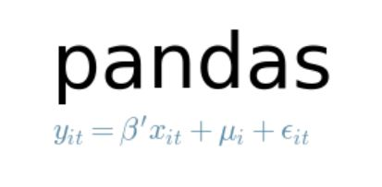
Pandas: An Introduction
Primary tool for dealing with outside data
Uses a data structure called a dataframe to do its work.
Works like a massive Excel spreadsheet that you can dynamically program
Notes:
3-5 MINUTES
TALKING POINTS
After this slide, go back to notebook and build a dataframe out of a numpy array, and then use pd.read_csv()

Slide 16
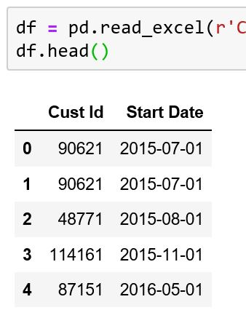
Pandas: Connecting to Data
Pandas connects to following:
CSV
Excel
SQL
JSON
STATA
SAS
HTML
others
All use the same syntax pd.read_data_type_here()
Notes:
3-5 MINUTES
TALKING POINTS
After this slide, go back to notebook and build a dataframe out of a numpy array, and then use pd.read_csv()

Slide 17
Selecting & Querying Data in Pandas
Python For Data
Notes:
X MINUTES
TALKING POINTS
This is a suggested talking point.
This is another.
TEACHING TIPS
This is a suggestion for the instructor on something to do before, during or after presenting this slide.
This is another suggestion.

Slide 18
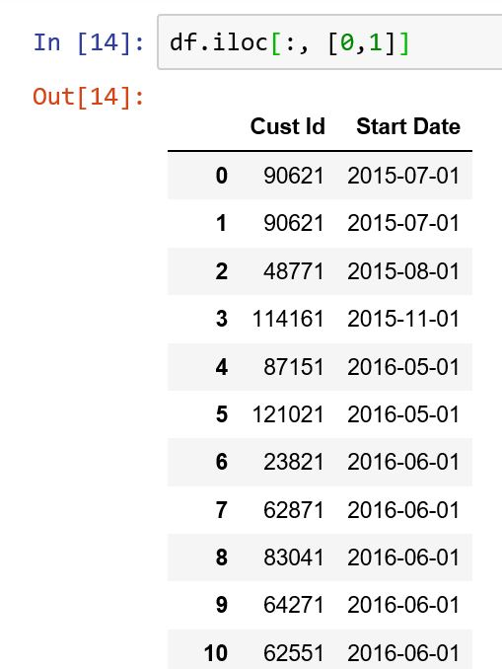
Pandas: Selecting Data
Can select data via rows and columns
Can grab values both using labels and index positions
Usually happens with two primary commands:
.loc: grab data by its labels
.iloc: grab data by its index position
Notes:
3-5 MINUTES
TALKING POINTS
Go back into Jupyter notebook, and demonstrate how these commands work:
Try going over the following:
Grabbing one and multiple columns using labels
Column and row notation
Using both the .loc and .iloc commands, and their various manifestations.

Slide 19
Activity #1
Complete Section 1 Of Your Class Lab
Take 10 minutes to practice selecting and indexing your data
Notes:
X MINUTES
TALKING POINTS
This is a suggested talking point.
This is another.
TEACHING TIPS
This is a suggestion for the instructor on something to do before, during or after presenting this slide.
This is another suggestion.

Slide 20
Pandas: Selecting Data w/ Conditions
Can use Pandas to query data similar to what you’d use in SQL
Allows you to dynamically select different columns with complex conditions
Uses a slightly different syntax than traditional Python selection operators
Notes:
3-5 MINUTES
TALKING POINTS
After this slide, go back to Jupyter notebook and demonstrate different querying techniques:
Selecting based on one condition
Selecting with AND/OR keywords
How to select individual columns with queries

Slide 21
Activity #2
Complete Exercise #2 In Your Lab
Take 10 minutes to practice querying your data. Use the answers provided to confirm that you did the operation correctly.
Notes:
X MINUTES
TALKING POINTS
This is probably a good time to go to lunch.

Slide 22
Creating and Manipulating Data in Pandas
Python For Data
Notes:
X MINUTES
TALKING POINTS
This is a suggested talking point.
This is another.
TEACHING TIPS
This is a suggestion for the instructor on something to do before, during or after presenting this slide.
This is another suggestion.

Slide 23
Pandas: Creating Data
Variables are manipulated using vectorized code
Means you basically treat columns and datasets as a single variable
A bit different from regular Python: no loops!
Notes:
3-5 MINUTES
TALKING POINTS
After this slide, go back to Jupyter notebook and demonstrate different querying techniques:
Selecting based on one condition
Selecting with AND/OR keywords
How to select individual columns with queries

Slide 24
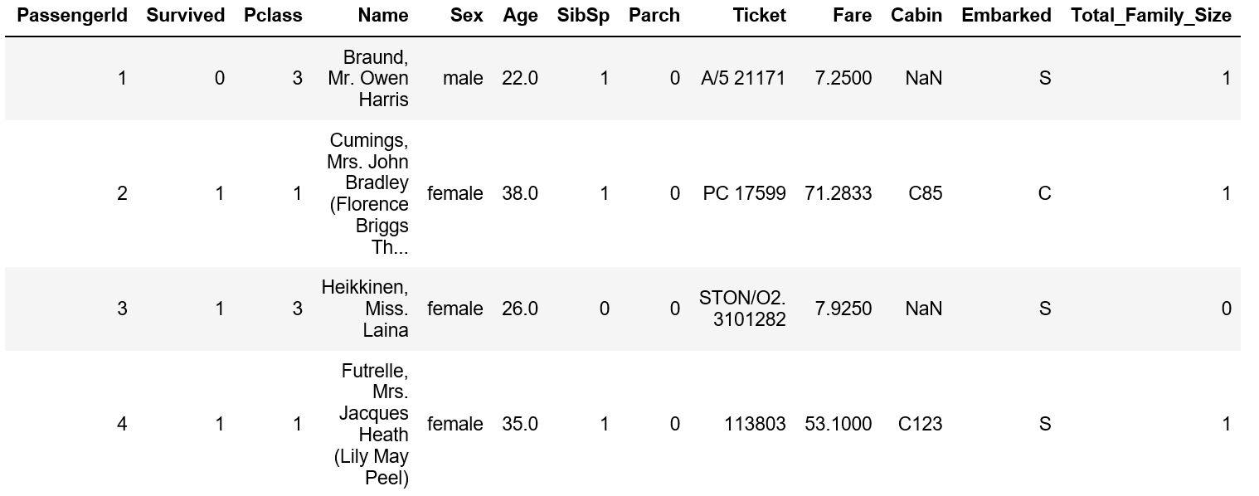
Activity #3
Create a new column called ‘family_size’ that’s the combination of the SibSP and Parch columns. This column indicates the total amount of company everyone had on board with them.
Notes:
X MINUTES
TALKING POINTS
This is probably a good time to go to lunch.

Slide 25
Pandas: Creating Data
You can think of pandas methods for creating data falling into two categories: general and particular.
3 general methods:
np.where()
np.select()
df.apply()
Notes:
3-5 MINUTES
TALKING POINTS
After this slide, go back to Jupyter notebook and demonstrate different querying techniques:
Selecting based on one condition
Selecting with AND/OR keywords
How to select individual columns with queries

Slide 26
Pandas: Creating Data
Methods for specific ways of changing data:
pd.cut() – turn a numeric category into predefined bins
df.map() – change values in a column from one to another
df.replace() – replace specific values with something else
Notes:
3-5 MINUTES
TALKING POINTS
After this slide, go back to Jupyter notebook and demonstrate different querying techniques:
Selecting based on one condition
Selecting with AND/OR keywords
How to select individual columns with queries

Slide 27
Pandas: Creating Data
np.where():
Simple way to create if/else statement to create new variables
np.select():
Advanced version of np.where() - can create multiple conditions
Notes:
3-5 MINUTES
TALKING POINTS
After this slide, go back to Jupyter notebook and demonstrate different querying techniques:
Selecting based on one condition
Selecting with AND/OR keywords
How to select individual columns with queries

Slide 28
Activity #4
Complete section 4 of your lab. Finish this section with a partner if you’d like.
Notes:
X MINUTES
TALKING POINTS
This is probably a good time to go to lunch.

Slide 29
Cleaning Data
Python For Data
Notes:
X MINUTES
TALKING POINTS
This is a suggested talking point.
This is another.
TEACHING TIPS
This is a suggestion for the instructor on something to do before, during or after presenting this slide.
This is another suggestion.

Slide 30
Pandas: Cleaning Data
Built in methods for doing the following:
Detecting empty values
Selecting data depending on certain data types
Detecting duplicates
Filling in missing values
Renaming columns
Notes:
3-5 MINUTES
TALKING POINTS
After this slide, go back to Jupyter notebook and demonstrate different querying techniques:
Selecting based on one condition
Selecting with AND/OR keywords
How to select individual columns with queries

Slide 31
Empty Values
To detect empty values:
df.isnull()
To detect filled values:
df.notnull()
Both of these can be further aggregated to figure out how often they occur in particular columns
Notes:
3-5 MINUTES
TALKING POINTS
After this slide, go back to Jupyter notebook and demonstrate different querying techniques:
Selecting based on one condition
Selecting with AND/OR keywords
How to select individual columns with queries

Slide 32
Renaming/Dropping Columns
To rename columns:
df.rename()
To drop columns:
df.drop()
Important details:
These operations can be applied across both columns and rows (ie, have an axis argument)
Can be applied inplace.
Notes:
3-5 MINUTES
TALKING POINTS
After this slide, go back to Jupyter notebook and demonstrate different querying techniques:
Selecting based on one condition
Selecting with AND/OR keywords
How to select individual columns with queries

Slide 33
Filling in Missing Values:
df.fillna()
Dropping Missing Values:
df.dropna()
Has any/all parameters
To detect duplicates:
df.duplicated()
To drop duplicates:
df.drop_duplicates()
Notes:
3-5 MINUTES
TALKING POINTS
After this slide, go back to Jupyter notebook and demonstrate different querying techniques:
Selecting based on one condition
Selecting with AND/OR keywords
How to select individual columns with queries

